Slide 1

CODEMETRIC TECHNOLOGY
SEED-GO
ALLEN, SCOTT NICHOLAS
180923 / 620099245
CLARKE, KHADEJA RENEE
180908 / 620098443
NEILL, MISCHKA ZOILA
180913 / 620100135

Slide 2
AGENDA
INTRODUCTION OF TEAM MEMBERS AND THEIR CONTRIBUTIONS TO THE PROJECT
OVERVIEW OF APPLICATION
BREAKDOWN / DEMO OF APPLICATION
FUTURE IMPLEMENTATIONS
QUESTIONS AND COMMENTARY

Slide 3
INTRODUCTION OF TEAM MEMBERS AND THEIR CONTRIBUTIONS TO THE PROJECT

Slide 4
OVERVIEW OF APPLICATION

Slide 5
OVERVIEW OF APPLICATION
BUILD LANGUAGES: JAVA, KOTLIN
TARGET SDK VERSION: 28
MINIMUM SDK VERSION: 26
THIRD-PARTY LIBRARIES: Jsoup, Expandable CardView, Jools, Groupie, BarcodeReader

Slide 6
BREAKDOWN OF APPLICATION

Slide 7
BREAKDOWN OF APPLICATION (cont’d)
USER AUTHENTICATION

Slide 8
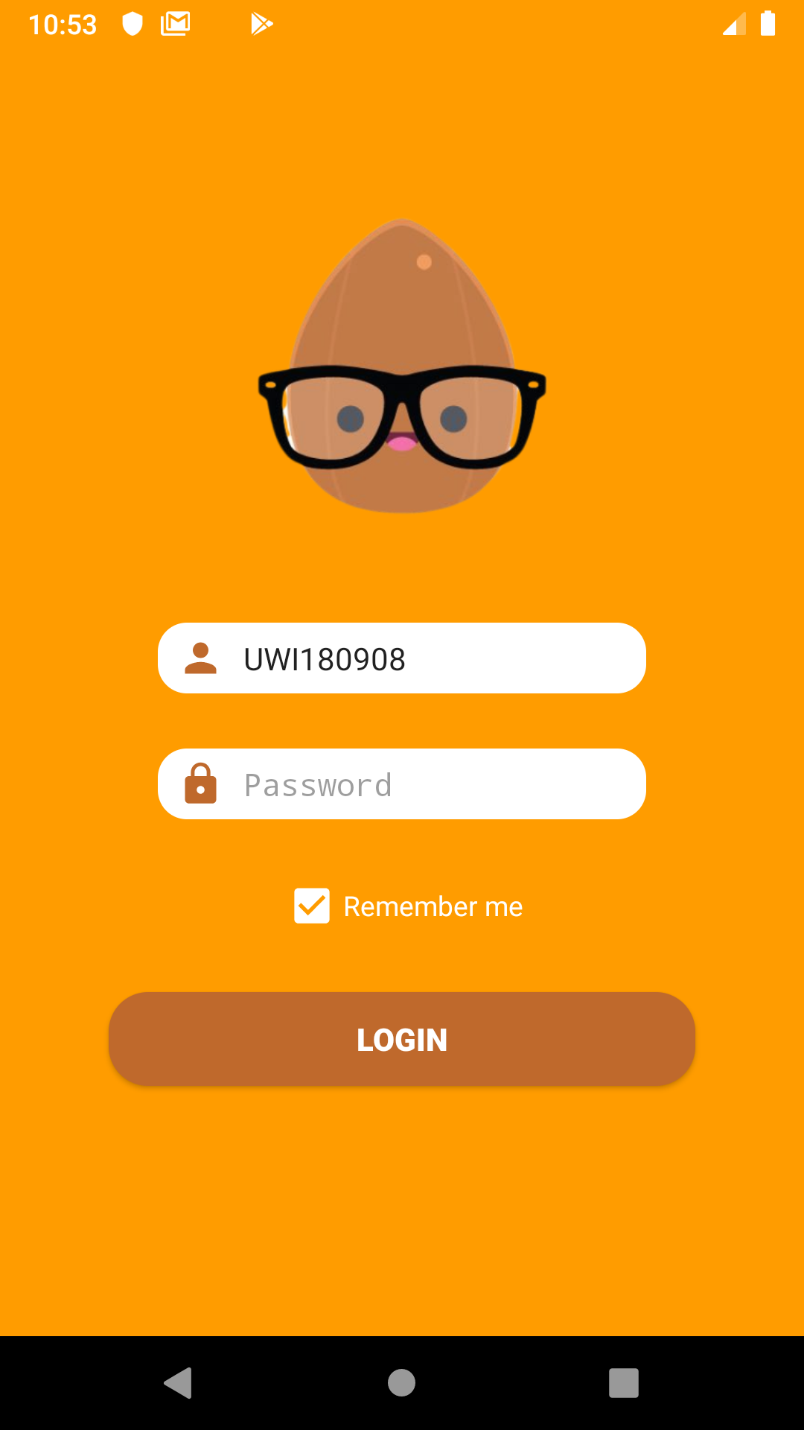
USER AUTHENTICATION
LOGIN

Slide 9
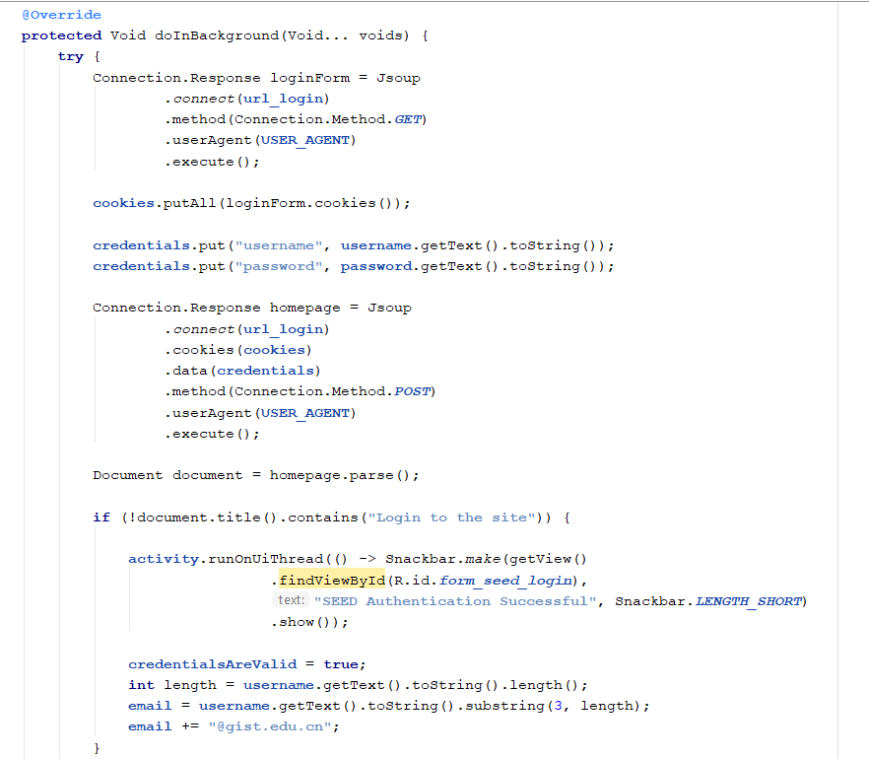
USER AUTHENTICATION - SEED AUTHENTICATION

Slide 10
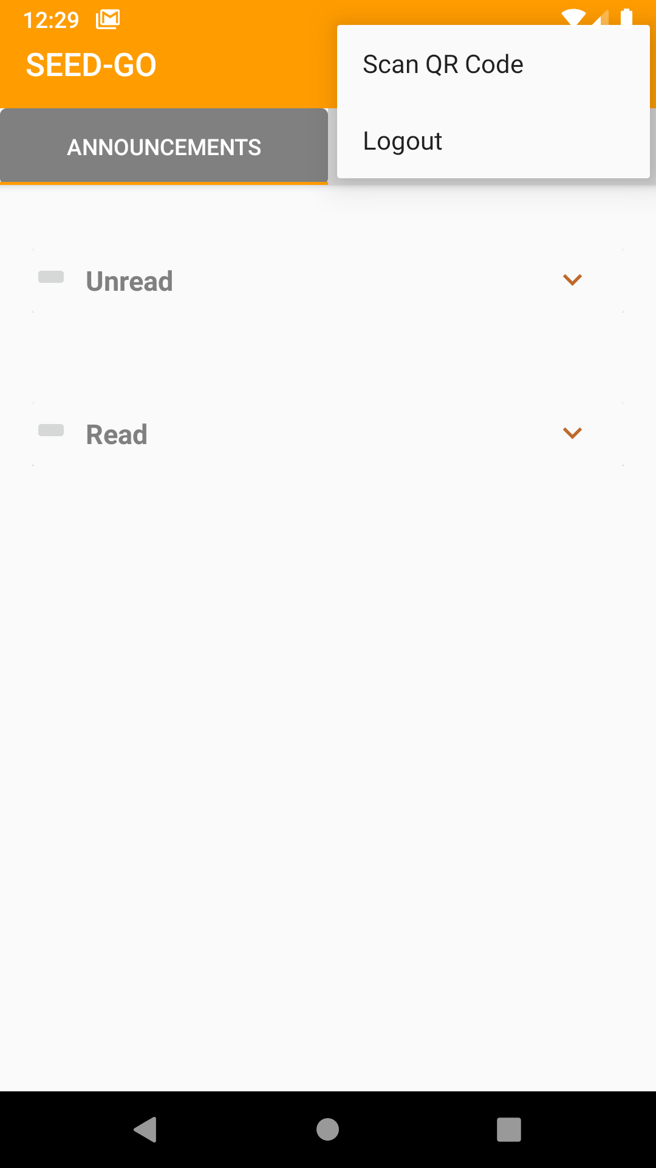
USER AUTHENTICATION
LOGOUT

Slide 11
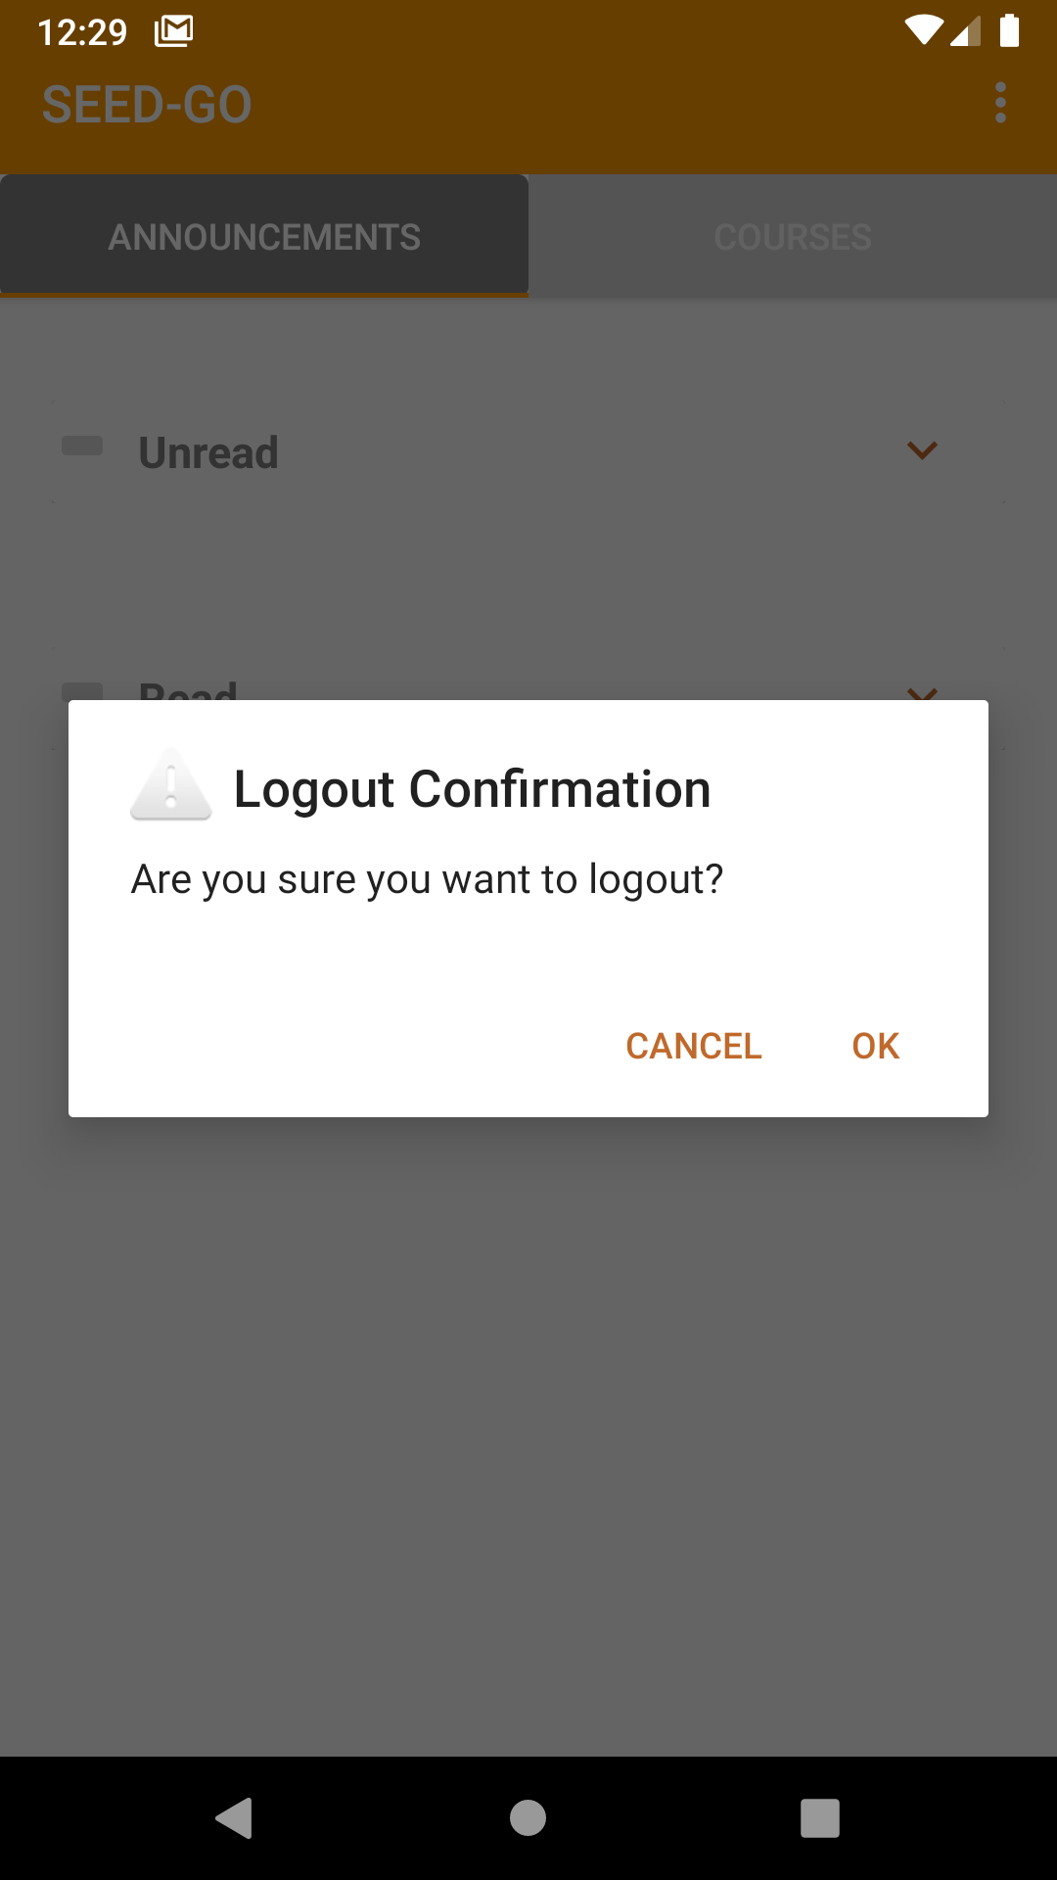
USER AUTHENTICATION
LOGOUT CONFIRMATION DIALOG

Slide 12
BREAKDOWN OF APPLICATION (cont’d)
Announcements - all

Slide 13
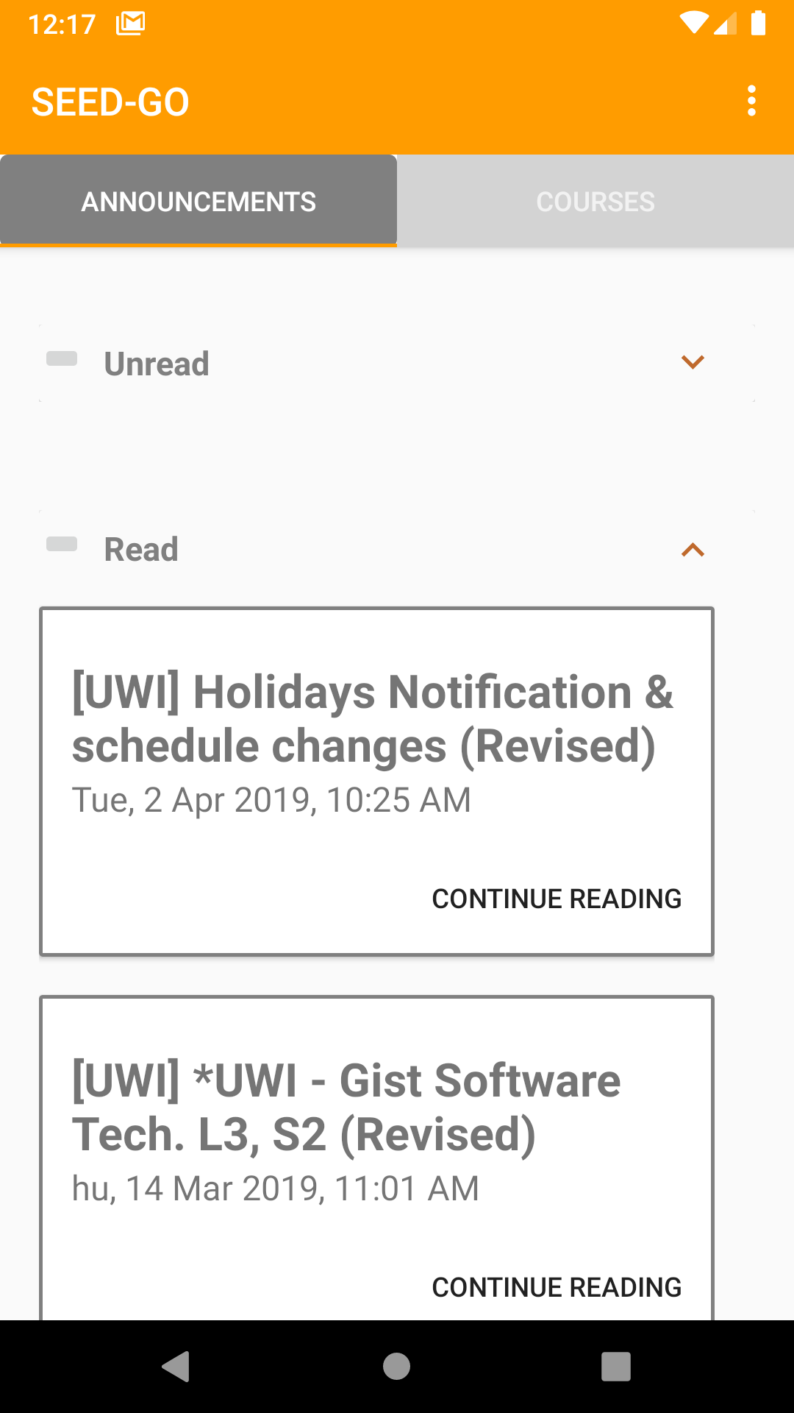
ANNOUNCEMENTS
UNREAD VS READ

Slide 14
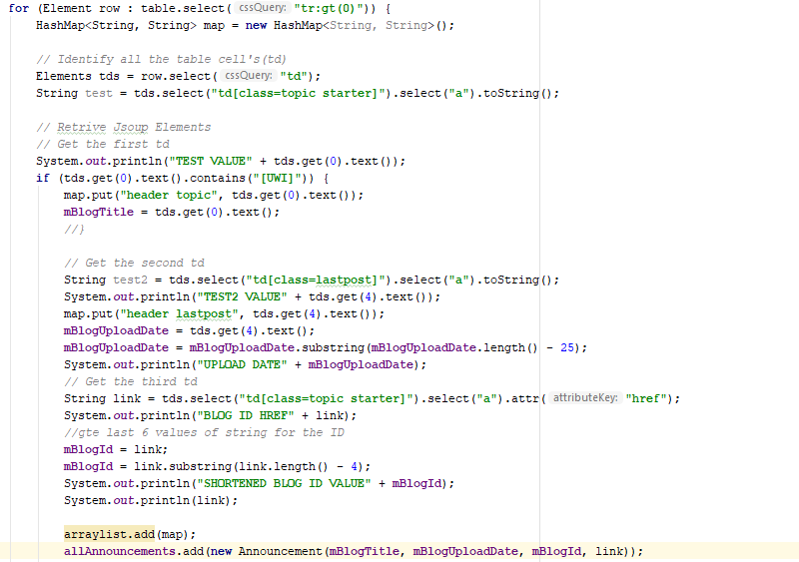
ANNOUNCEMENTS
Loading the elements from the page to an instance of an Announcement

Slide 15
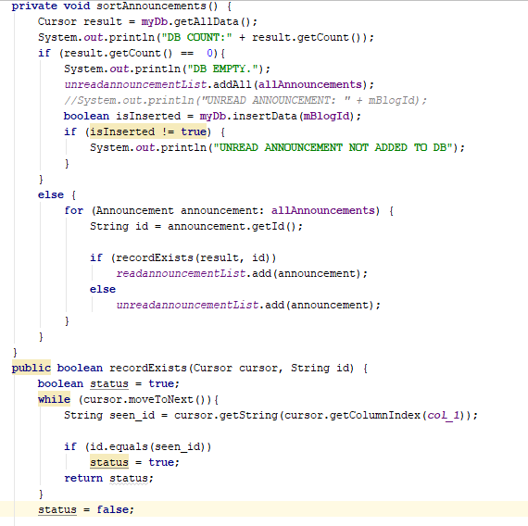
ANNOUNCEMENTS
Loading unread vs read announcements

Slide 16
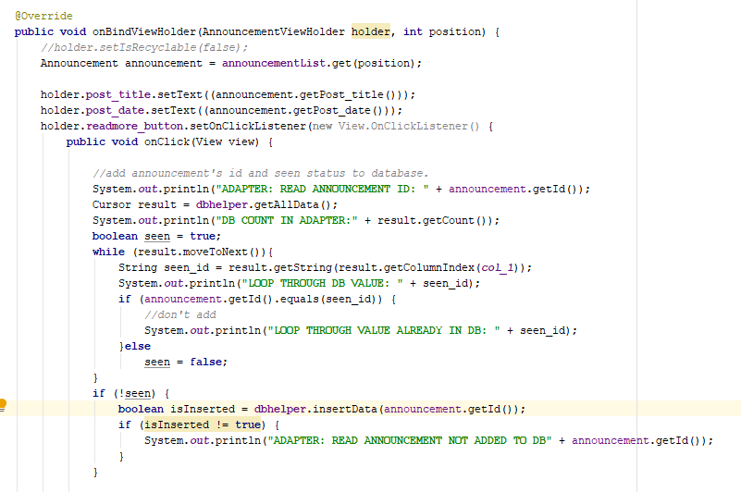
ANNOUNCEMENTS
Moving an announcement from unread to the read category for the next loading of the announcements page in the adapter

Slide 17
BREAKDOWN OF APPLICATION (cont’d)
VIEW AN ANNOUNCEMENT

Slide 18
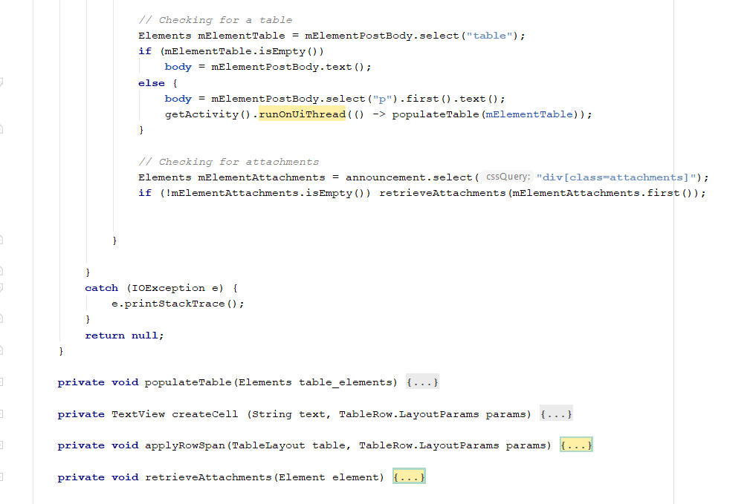
VIEW announcement
ANNOUNCEMENT WITH ATTACHMENTS

Slide 19
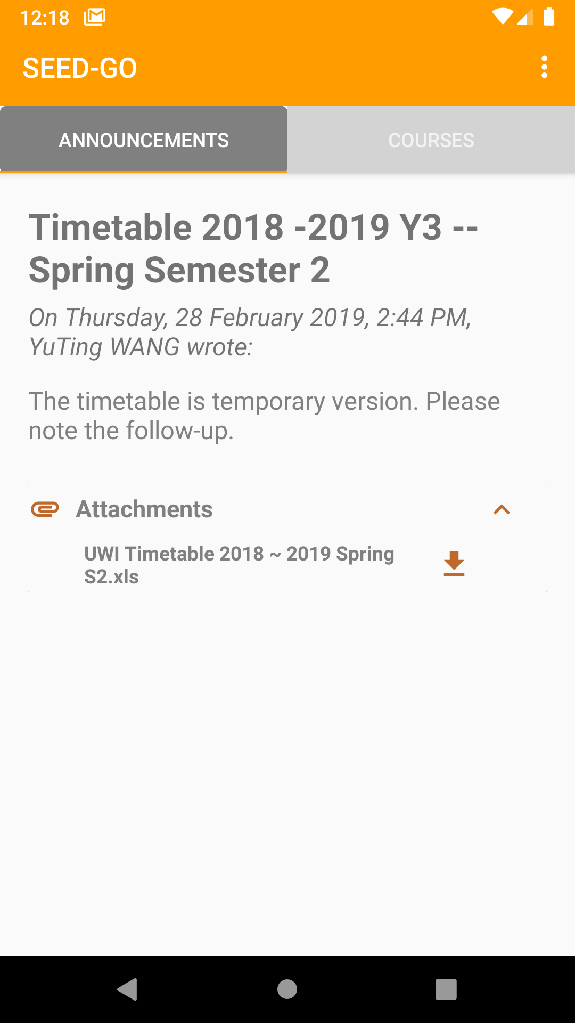
VIEW ANNOUNCEMENT
AN ANNOUNCEMENT WITH ATTACHMENTS

Slide 20
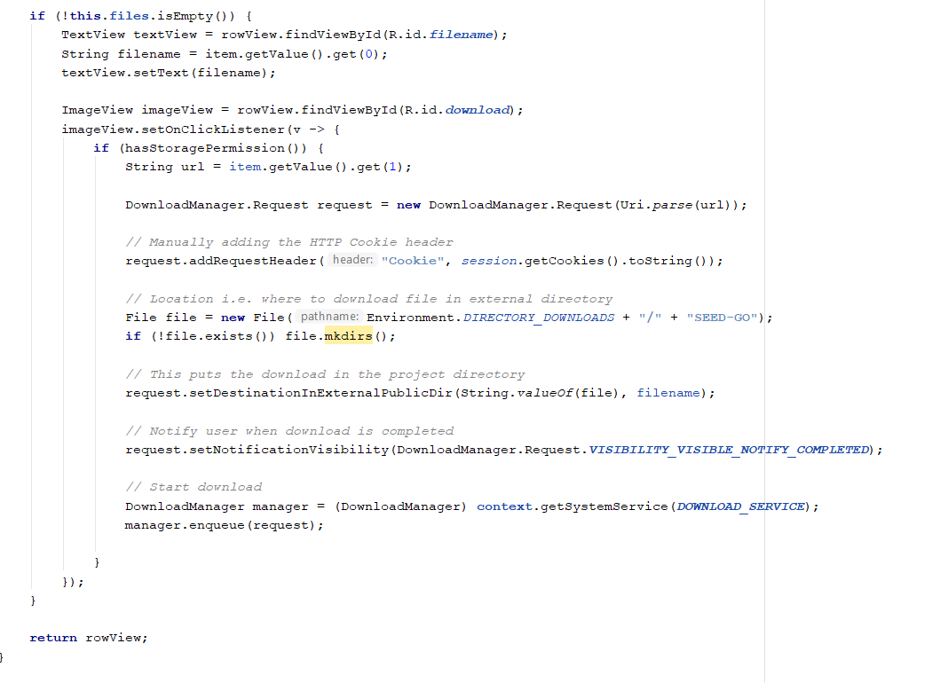
VIEW announcement
ANNOUNCEMENT WITH ATTACHMENTS

Slide 21
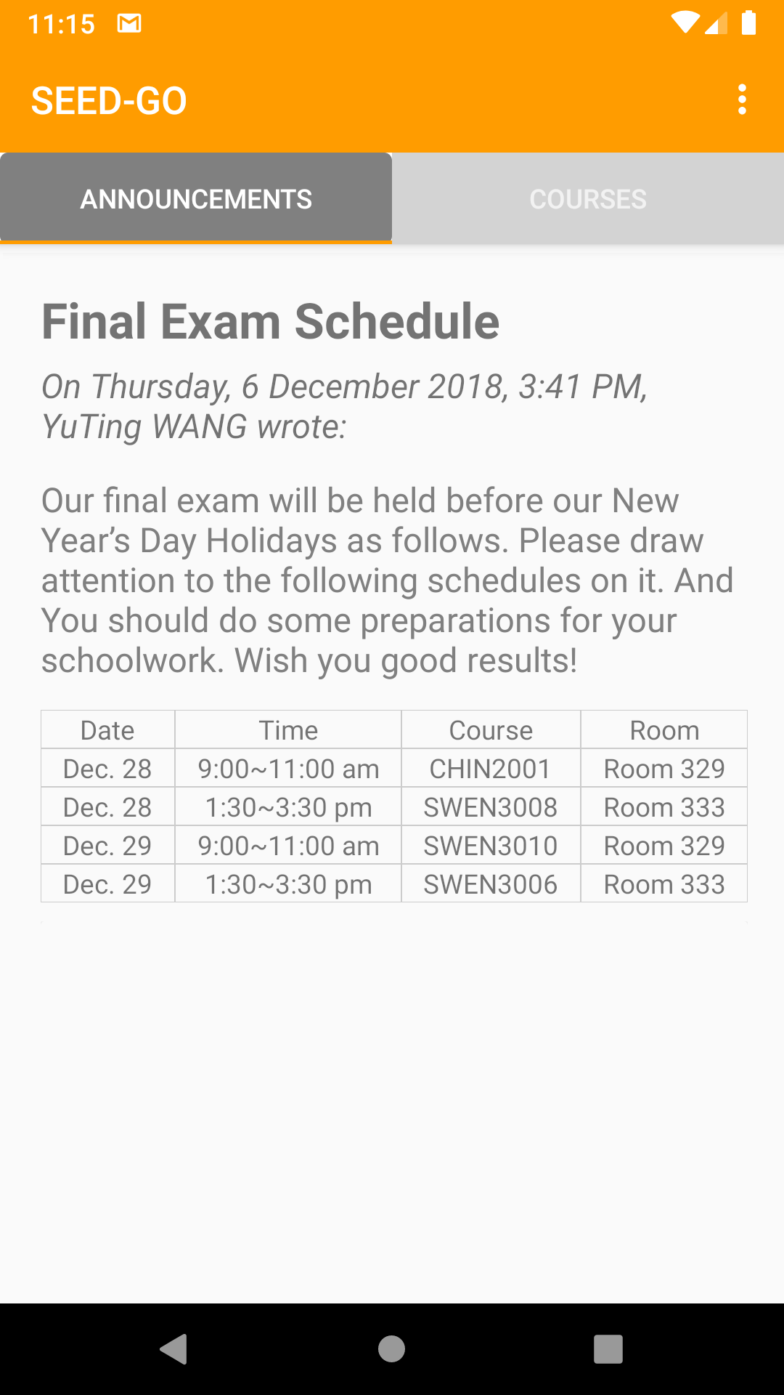
VIEW ANNOUNCEMENT
AN ANNOUNCEMENT WITH A TABLE

Slide 22
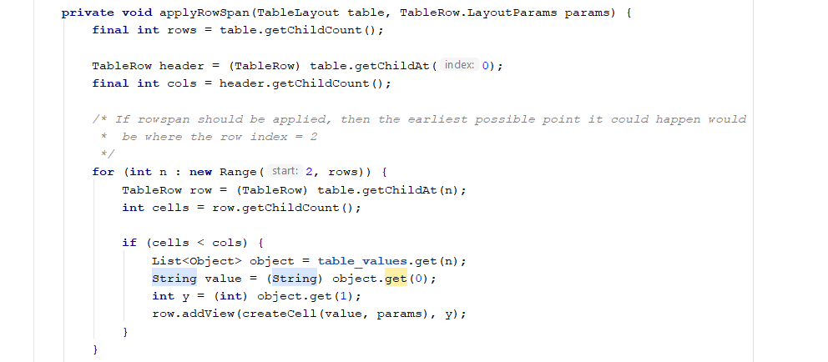
VIEW announcement
ANNOUNCEMENT WITH A TABLE

Slide 23
BREAKDOWN OF APPLICATION (cont’d)
COURSES

Slide 24
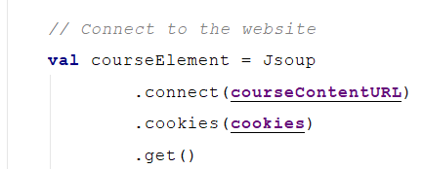
COURSES
Connect to course page

Slide 25
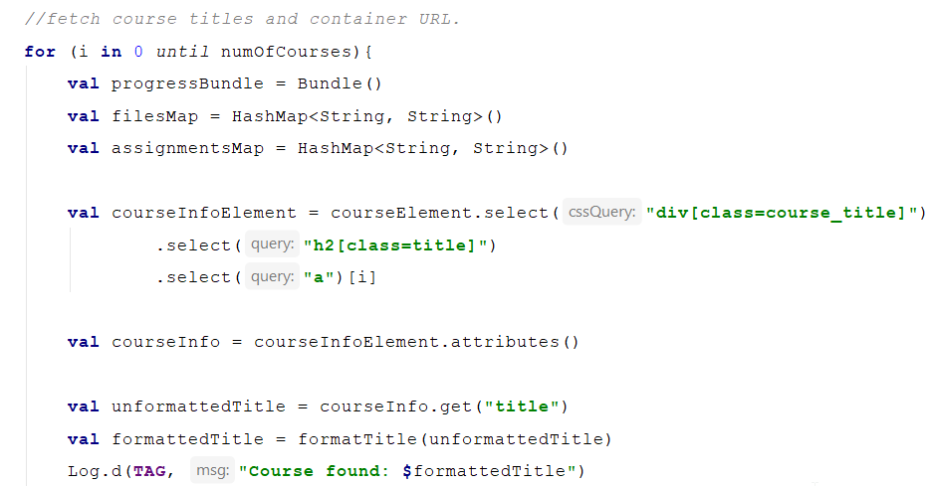
COURSES
Extract course details

Slide 26
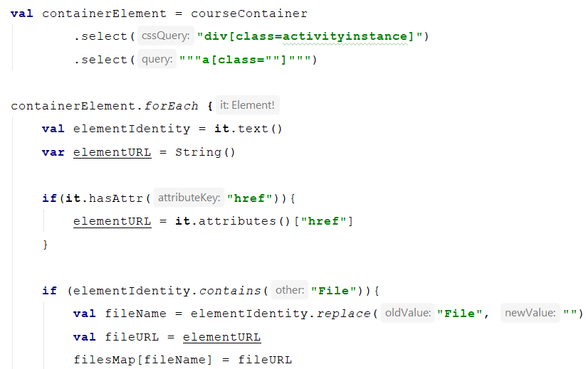
COURSES
Extract information from course container element

Slide 27
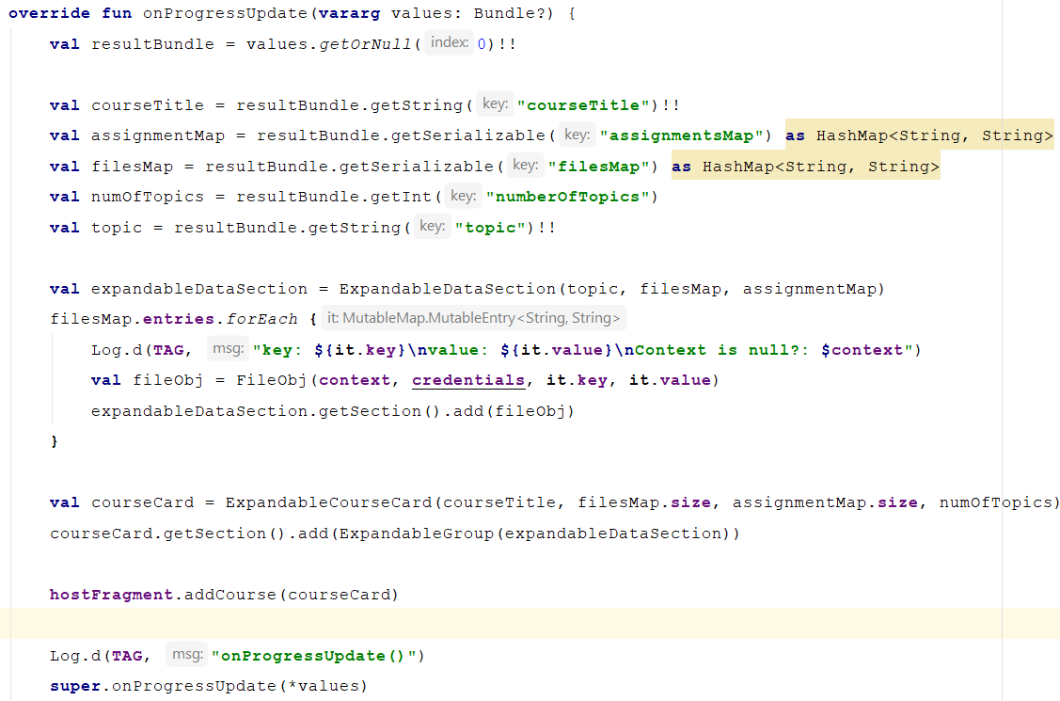
COURSES
Update course

Slide 28
QUESTIONS and COMMENTS

